Slide 1
CSCI Final Project

Slide 2
Problem and Hypothesis
I am trying to predict the total daily bike rentals demand based on factors like weather conditions (temperature, humidity, windspeed), and calendar variables (season, holiday, working day)
Null Hypothesis: For the bike-sharing dataset, there will be no significant difference in bike rental demand across different times, weather conditions, or locations.
Alternative Hypothesis: For the bike-sharing dataset, there will be a significant difference in bike rental demand based on time of day, weather conditions, or specific locations.

Slide 3
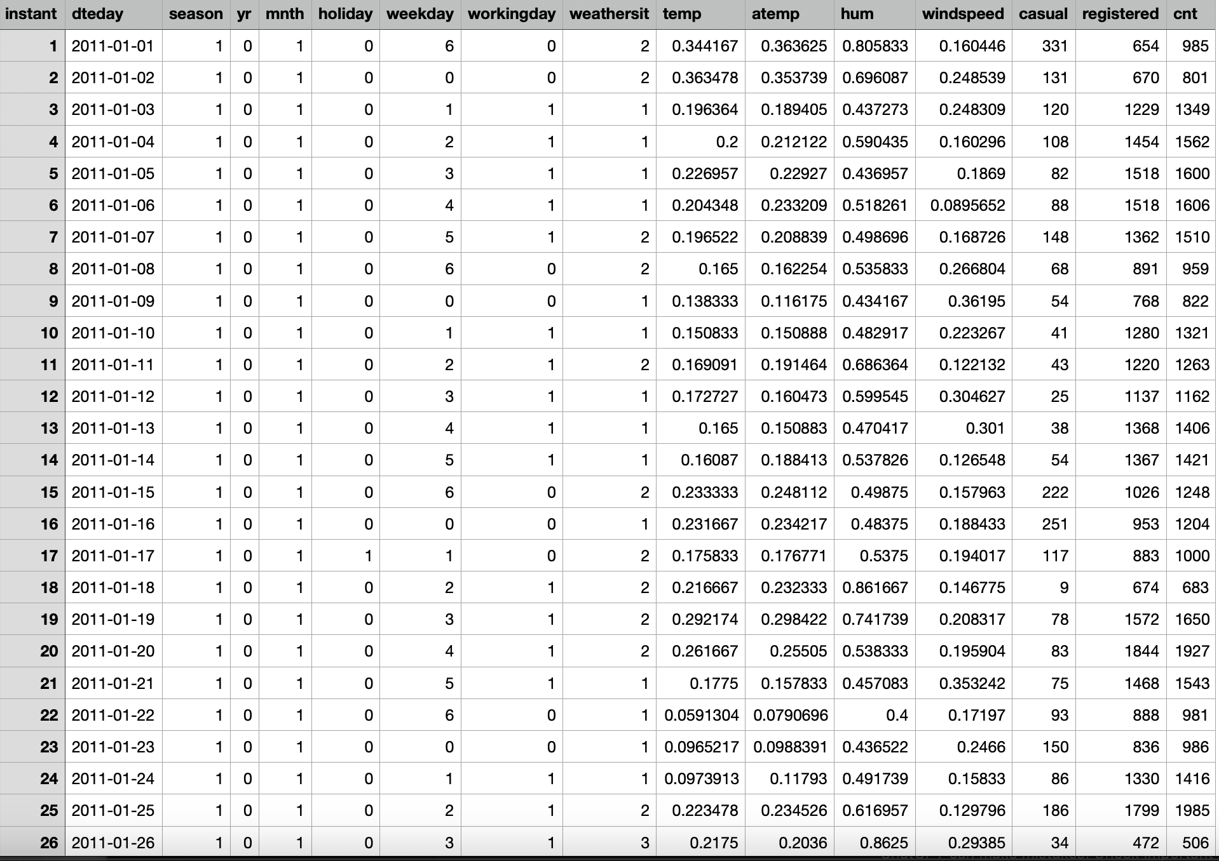

Slide 4
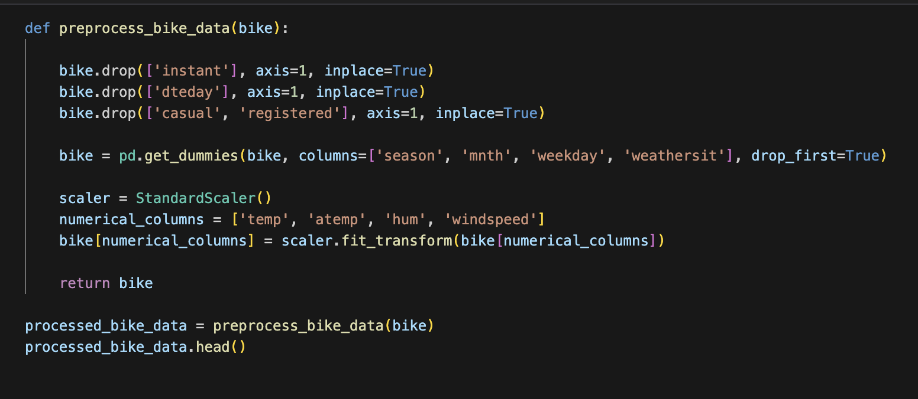
Cleaning Steps
Dropped unnecessary columns
One Hot encoded categorical columns
Standard scaled numerical columns

Slide 5
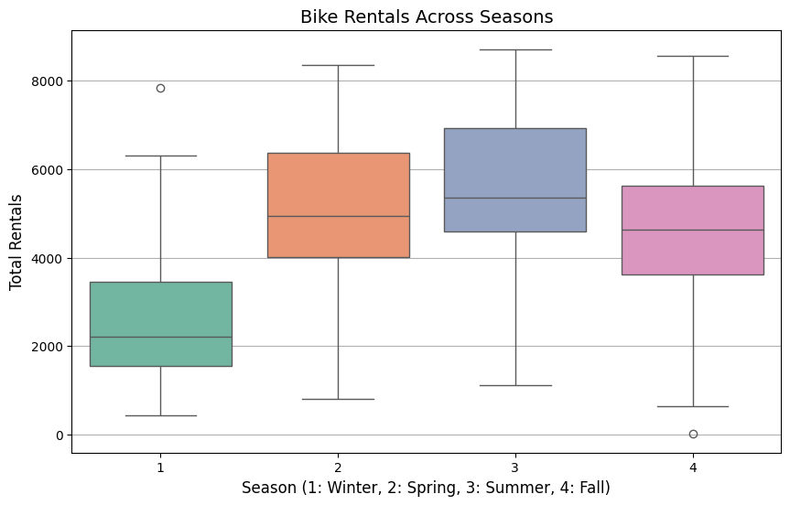
The first visual, a boxplot of bike rentals across seasons, shows how bike rental patterns vary seasonally. It helps identify seasonal trends, such as higher rentals in summer and fall compared to winter and spring.

Slide 6
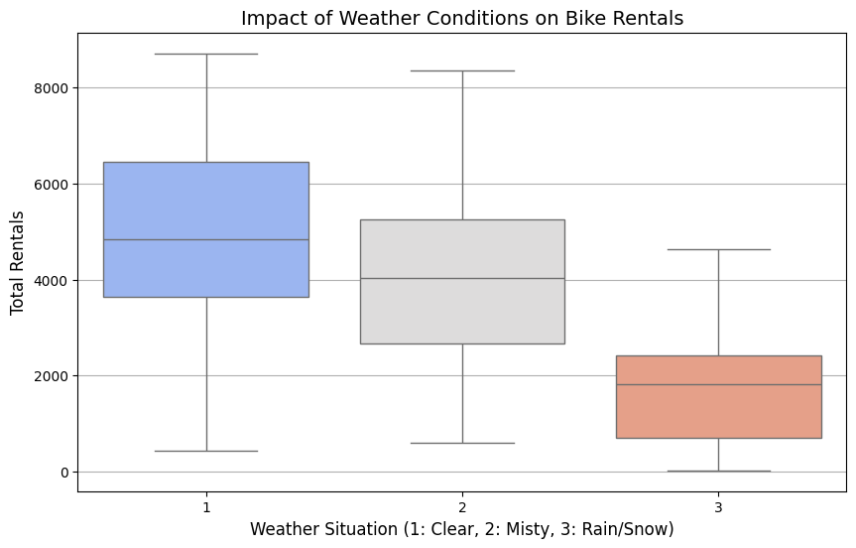
The second visual, a boxplot illustrating the impact of weather conditions on bike rentals. Clear weather tends to correspond with higher rental numbers, while conditions like rain or snow are associated with lower rentals. This suggests that bike rental demand is quite sensitive to weather.

Slide 7
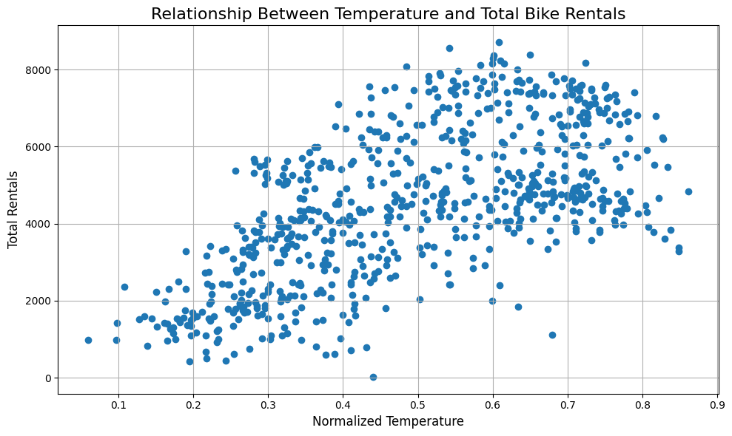
This scatter plot shows the relationship between normalized temperature and total bike rentals.The scatter plot reveals a positive correlation between temperature and total bike rentals, with warmer weather driving higher usage.

Slide 8
Models
The models I used is a linear model and random forest.
Using both linear models and Random Forest is a good approach for the bike rentals dataset because they handle different aspects of the problem. Linear models are simple and help capture straightforward relationships, like how temperature affects rentals, while Random Forest handles more complex patterns, like interactions between weather, seasons, and holidays. The linear model provides clear insights, and Random Forest captures details the linear model might miss.

Slide 9
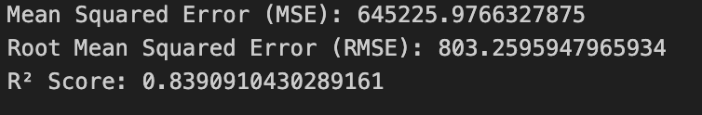
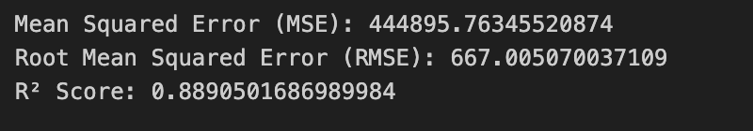
Linear Model pre optimization results
Linear Model post optimization results

Slide 10
Optimization steps
F-regression: F-regression computes the correlation between each feature and the target to test their significance. Features with a p-value less than 0.05 are selected as significant, reducing irrelevant or noisy predictors.
Polynomial Features: Adds interaction terms (products of pairs of features) to capture relationships between features that a purely linear model might miss.
Ridge regression (L2 regularization) is applied to shrink coefficients of less important features toward zero. I set the parameter alpha to 1 to controls the strength of this shrinkage, balancing overfitting and underfitting.

Slide 11
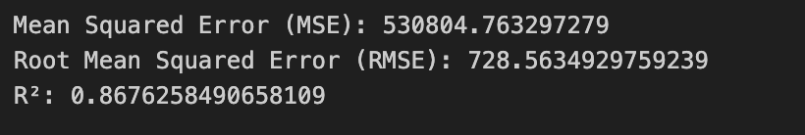
Random Forest pre optimization results
Random Forest post optimization results

Slide 12
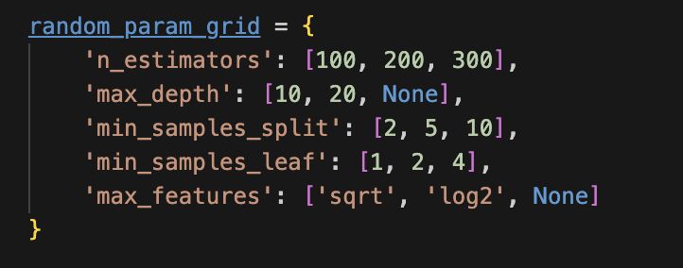
Optimization steps
For the optimization of random forest I just used a randomized search cross validation.(RandomizedSearchCV)

Slide 13
Conclusion
The results of both the Linear Model and Random Forest support the alternative hypothesis because:
The high R² values in both models indicate a strong relationship between the predictors and the outcome variable (bike rental demand).
This implies significant differences in bike rental demand across the factors included in the models (time of day, weather, and location).

